Slide 1
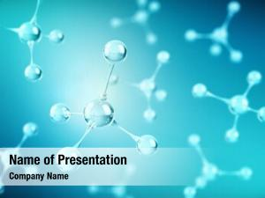

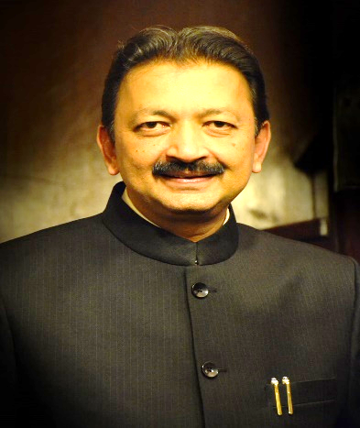
B. K. Birla College, Kalyan
(Empowered Autonomous Status)
Department of Environmental Sciences
celebrates
World Ozone Day
Special Guest Lecture
Topic
Healing the Sky, Nurturing the Soil:
Ozone, Agriculture and the National Agro-Village Renaissance
Date : Tuesday, the 16th September 2025
Time: 10.00 am to 11.30 am
Venue: Room No. 009, New Building
Prof. Sanjay Deshmukh
PhD, DSc (h.c.), LLB, DSc (h.c.), LLM
Adjunct Professor- Institute of Chemical Technology (ICT)
HAG Sr. Professor (2015-2025);
Former Head, Univ. Dept. of Life Sciences;
Formerly, Vice-Chancellor - UNIVERSITY OF MUMBAI

